Slide 1

E-Commerce
WEBSITE

Slide 2

TEAM MEMBERS
01
Mayank Gupta (2110991946)
02
Mohd. Tariq (2110991954)
03
Vidhi Thakur (2110992088)
04
Nawed Alam (2110992080)

Slide 3
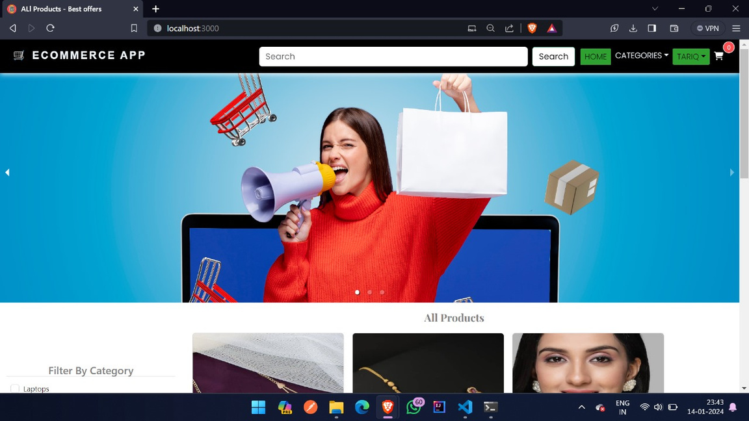
INTRODUCTION
An e-commerce website made using MERN Stack. Here, we have an admin who can add products and a customer who can purchase the products. Front-end is managed using react.js while backend is managed using node.js and express.js. Database is managed using mongoDB.

Slide 4

User Authentication and Authorization.
Product catalog and listings.
Shopping cart functionality.
Order processing and fulfillment process.
KEY FEATURES

Slide 5

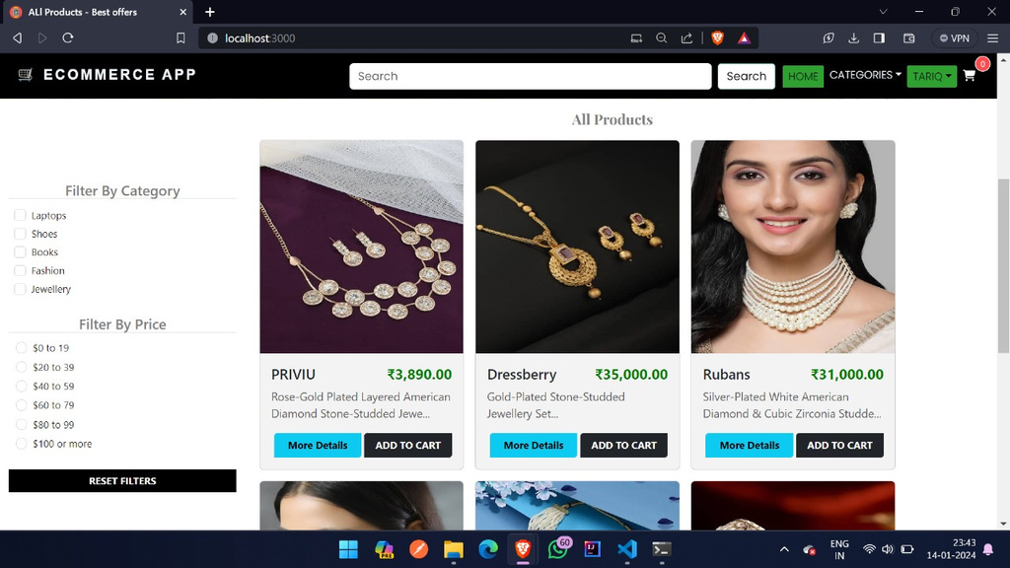

Slide 6

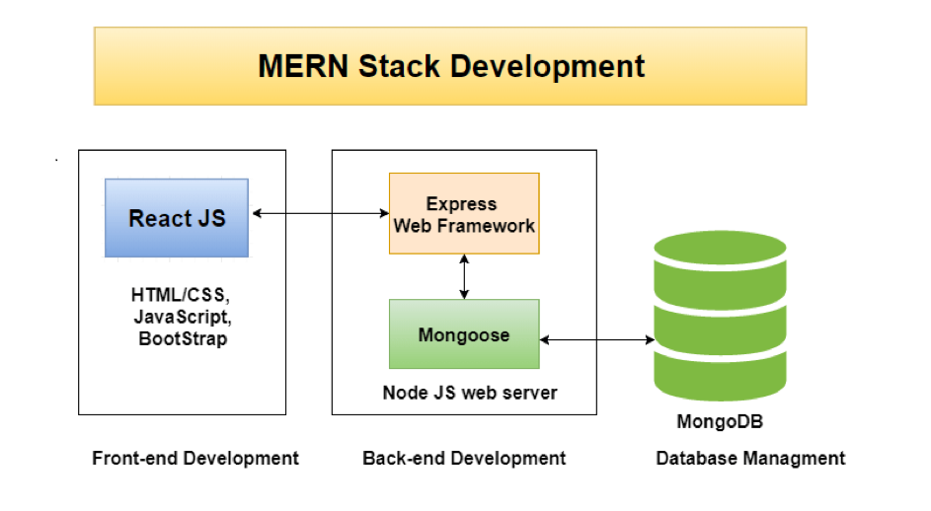
MERN Stack
ARCHITECTURE
Client side using React.js
Server side using Node.js
Database using MongoDB

Slide 7
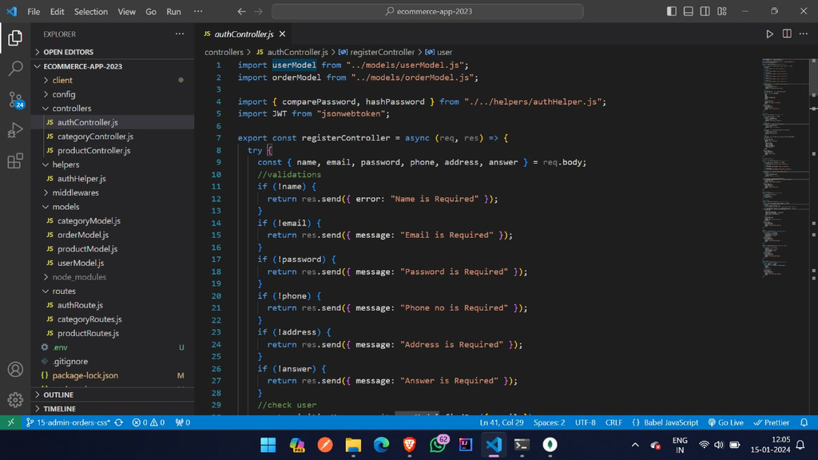
CLIENT SIDE
Component-based architecture
Virtual DOM for efficient rendering
State management with Redux

Slide 8
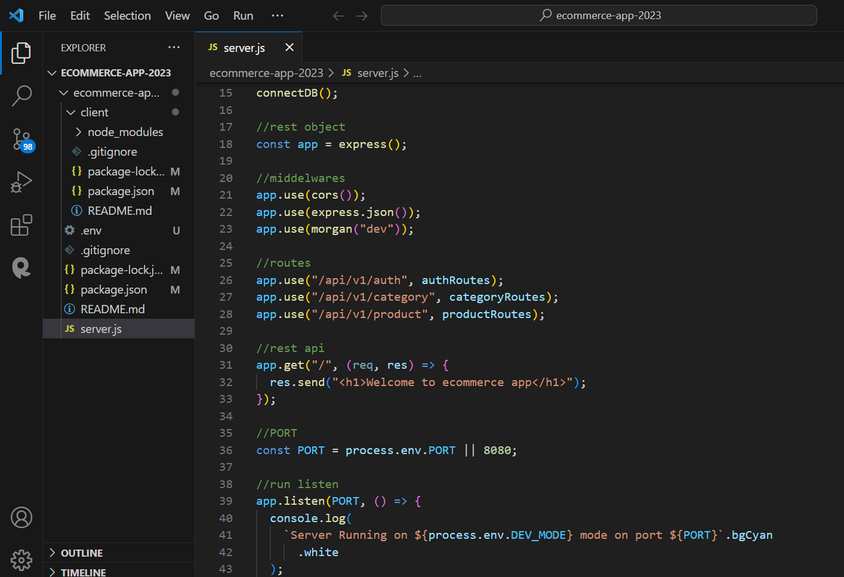
SERVER SIDE
Back-end development using Node.js and express.js
Building restful APIs
Middleware for handling request

Slide 9
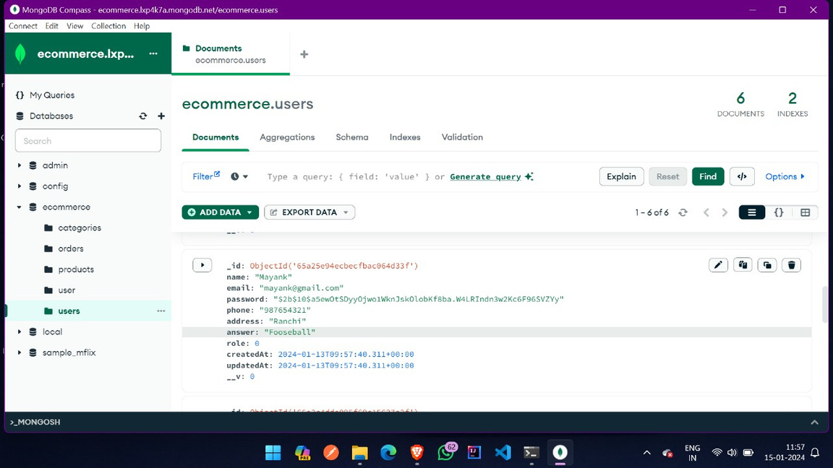
DATABASE MANAGEMENT
No-SQL advantage for e-commerce
JSON-like document structure
Mongoose for Node.js

Slide 10
DEPENDENCIES
FRONT-END
BACK-END
React-router-DOM
Axios
React-icons
React-DOM
React Moment
Braintree-web-drop-in
Express
Morgan
Mongoose
Dotenv
Nodemon
Bcrypt
Json Web Token

Slide 11
React-Router DOM
Axios
React Router DOM is an npm package that enables you to implement dynamic routing in a web app. It allows you to display pages and allow users to navigate them. It is a fully-featured client and server-side routing library for React.
Axios is a Javascript library used to make HTTP requests from node.js or XML Http Requests from the browser and it supports the Promise API that is native to JS ES6. It can be used intercept HTTP requests and responses and enables client-side protection against XSRF.

Slide 12
React-icons
React-DOM
React icons library is a great resource for React developers, who can use its customizable SVG icons in their applications. It offers an extensive library of icons to choose from, which can be easily inserted into projects with just a few lines of code.
ReactDOM is a package in React that provides DOM-specific methods that can be used at the top level of a web app to enable an efficient way of managing DOM elements of the web page.

Slide 13
React-Moment
Braintree-web-drop-in
React-moment is a React component that allows you to use the Moment.js library in your React applications. Moment.js is a JavaScript library that provides a robust set of tools for working with dates and times.
A pre-made payments UI for accepting cards and alternative payments in the browser built using version 3 of the Braintree JS client SDK. If you have any feedback or questions, create an issue or contact Braintree support.

Slide 14




BACKEND DEPENDENCIES
EXPRESS.JS
MORGAN
MONGOOSE
Express is a minimal and flexible Node.js web application framework that provides a robust set of features for web and mobile applications. APIs.
Morgan is another HTTP request logger middleware for Node. js. It simplifies the process of logging requests to your application.
Mongoose provides a straight-forward, schema-based solution to model your application data. It includes built-in type casting, validation, query building, business logic hooks and more, out of the box.

Slide 15
DOTENV
NODEMON
BCRYPT
Dotenv is a zero-dependency module that loads environment variables from a .env file into process.env. process.env now has the keys and values you defined in your .env file
Nodemon is a tool that helps develop Node.js based applications by automatically restarting the node application when file changes in the directory are detected. Nodemon does not require any additional changes to your code or method of development. nodemon is a replacement wrapper for node.
Bcrypt is a library used to hash your passwords. Bcrypt hashing is CPU intensive which will cause the sync APIs to block the event loop and prevent your application from servicing any inbound requests or events.

Slide 16
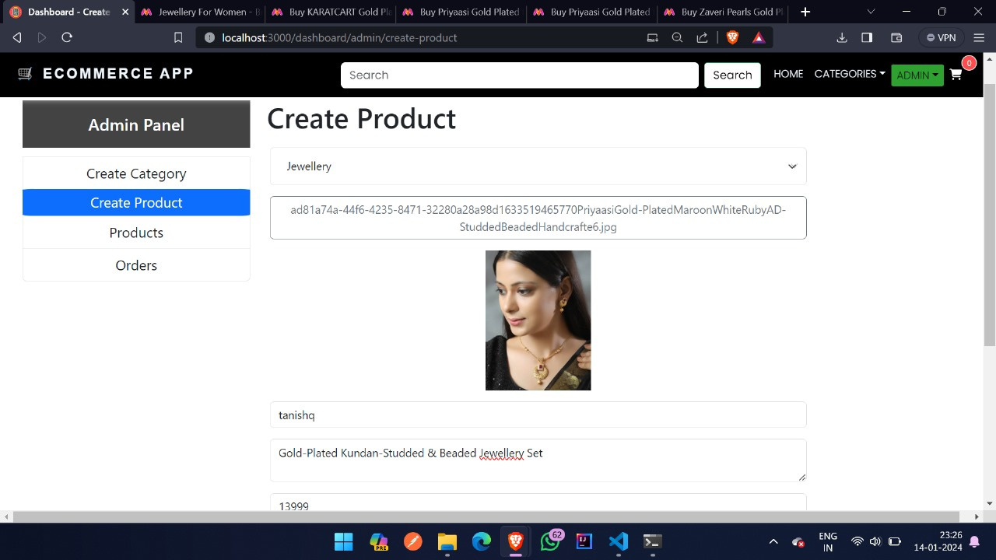
WORKING..
Here, we have an admin user who can create products, create categories etc.

Slide 17
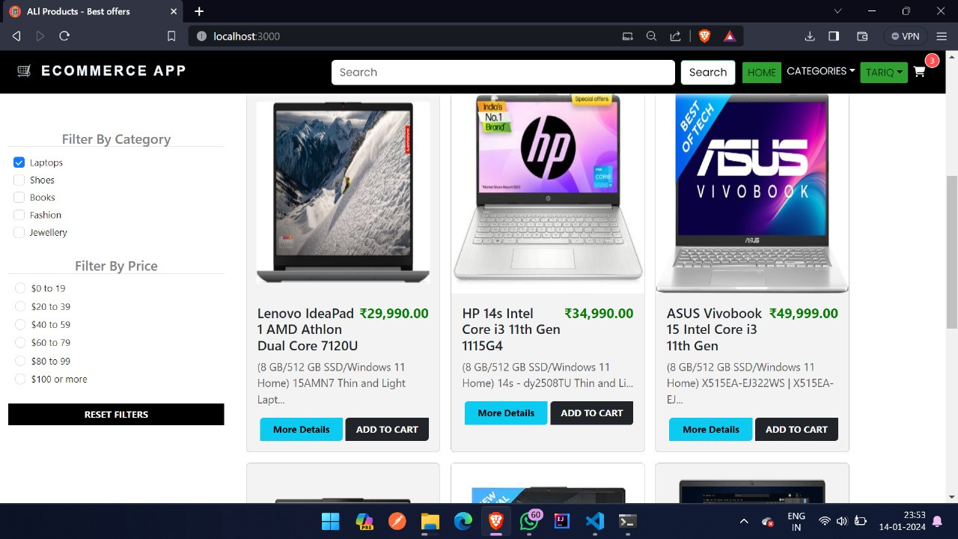
Now, the customer can select the products accordingly, filter it according to category, filter it by price and add it to cart also.

Slide 18
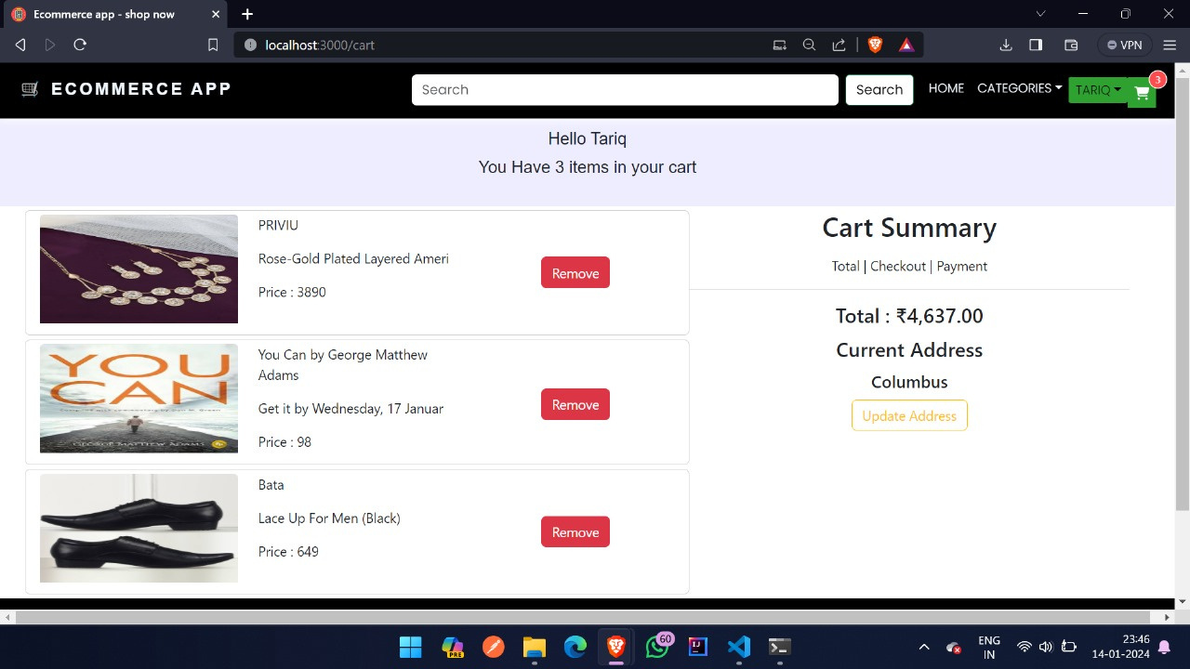
Here, products gets added to the cart and alongside the bill is shown.

Slide 19
Different categories of products are shown here.

Slide 20
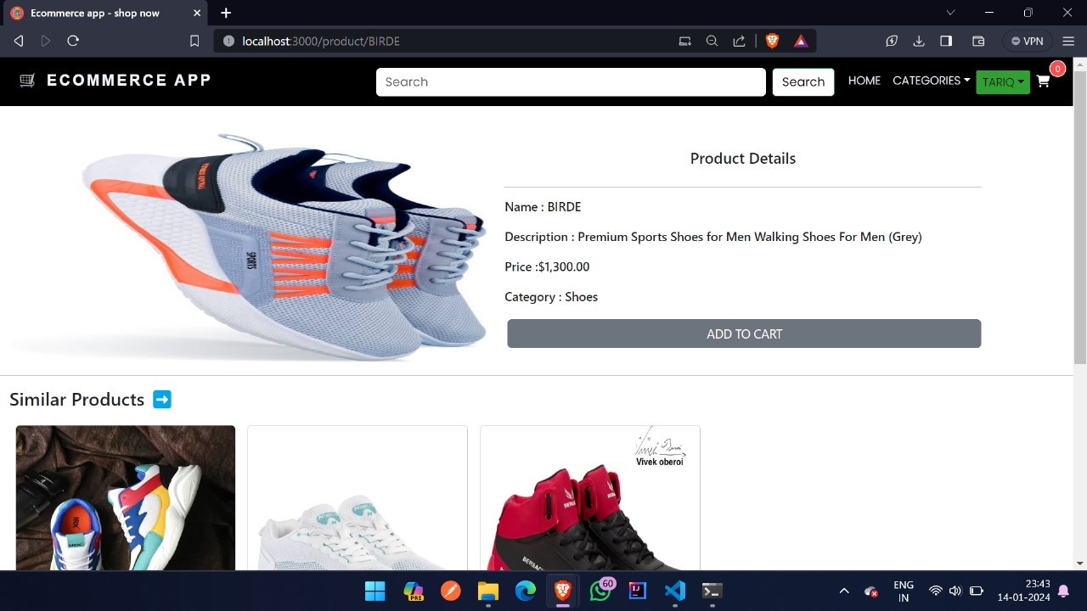

Slide 21


Slide 22
THANK YOU!

